Slide 1

Lesson 6-3
Variants of Turing Machines
Theory of Computation
王轩
Wang Xuan

Slide 2
Outline
Variations of the Standard Model
Simulation
Turing Machines with Stay-Option
Multitape Turing Machines
Nondeterministic Turing Machines
Enumerators

Slide 3




The Standard Model
Infinite Tape
Read-Write Head
(Left or Right)
Control Unit
Deterministic

Slide 4
Variations of the Standard Model
Turing machines with:
Stay-Option
Multitape
Nondeterministic
Enumerators
Different Turing Machine Classes

Slide 5
Simulations
Same Power of two machine classes:
both classes accept the
same set of languages
We will prove:
each new class has the same power
with Standard Turing Machine
(accept Turing-Recognizable Languages)

Slide 6
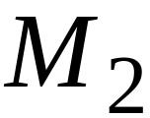
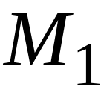
Simulation:
A technique to prove same power.
Simulate the machine of one class
with a machine of the other class
Second Class
Simulation Machine
First Class
Original Machine
simulates

Slide 7
Turing Machines with Stay-Option
The head can stay in the same position
Left, Right, Stay
δ: Q× Γ -> Q× Γ ×{L,R,S}

Slide 8



Example:
Time 1
Time 2

Slide 9
Theorem:
Stay-Option machines
have the same power with
Standard Turing machines
Proof:
1. Stay-Option Machines
simulate Standard Turing machines
2.
Standard Turing machines
simulate Stay-Option machines

Slide 10
1. Stay-Option Machines
simulate Standard Turing machines
Trivial: any standard Turing machine
is also a Stay-Option machine

Slide 11
2.
Standard Turing machines
simulate Stay-Option machines
We need to simulate the stay head option
with two head moves, one left and one right

Slide 12




Stay-Option Machine
Simulation in Standard Machine
For every possible tape symbol

Slide 13
For other transitions nothing changes
Stay-Option Machine
Simulation in Standard Machine
Similar for Right moves

Slide 14

example of simulation
Stay-Option Machine:
1
2
Simulation in Standard Machine:
1
2
3
END OF PROOF

Slide 15
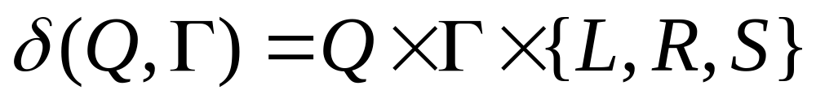
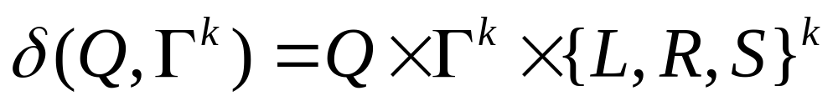
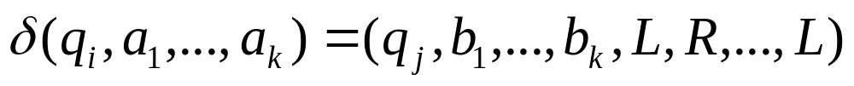
Multitape Turing Machines
Transition function in Turing machine with stay option
Multitape Turing machine has several tapes, each tape has its own head for reading and writing. Formally,
The expression

Slide 16



Multitape Turing Machines
Control unit
seems
powerful
(state machine)
Tape 1
Tape 2
Input string
Initially Input string appears on Tape 1

Slide 17
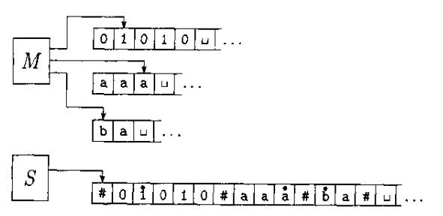
Standard Turing Machines (S)
Simulate Multi-tape machines (M)

Slide 18
Proof
S simulates k tapes of M by storing their information on its single tape, using # as a delimiter to separate different tapes.
To keep track the locations of the heads, write tap symbol with a dot above it to mark the place where the head on that tap would be, as “virtual” tapes and heads.

Slide 19

Details
S = “on input w=w1…wn:
  1. First s puts its tape into the format that represents all k tapes of M
  2. To simulate, it scan from the first #, to the (k+1)st#, in order to determine the symbols under the virtual heads. Then S makes a second pass to update the tapes according to M’s transition function.
  3. If S moves one of heads to the right onto a #, it signifies that M has moved the head onto the previously unread blank portion of the tape. So S write a blank symbol on this tap an shifts the tap contents, from this cell until the rightmost #, one unit to the right. Then it continues the simulation as before.

Slide 20
A language is Turing-recognizable if and only if some multitape Turing machine recognizes it.
Proof:
  An ordinary (single-tape) Turing machine is a special case of a multitape Turing machine.
  Every multitape Turing machine has an equivalent single-tape Turing machine.

Slide 21

Nondeterministic Turing Machines
Choice 1
Choice 2
Allows Non Deterministic Choices

Slide 22
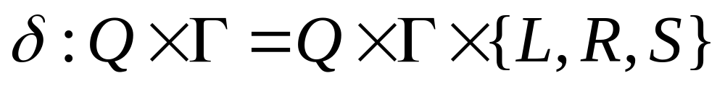
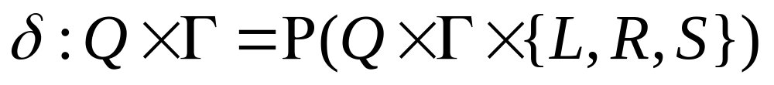
Transition Function
P means the computation is a tree whose branches correspond to different possibilities for the machine

Slide 23
Idea
Simulate nondeterministic TM N with a deterministic TM D. TM D try all possible branches of N. If D ever finds the accept state on one of them, D accepts.
View N’s computation on w as a tree. Each branch of the tree is one of the branches of nondeterminism. Each node of the tree is a configuration of N.
TM D Searches the tree for an accepting configuration
  Breadth first search: guarantee D will visit every node until it meets an accepting configuration
  Depth-first search: may go forever on infinite branch

Slide 24
All possible computation paths
Initial state
Step 1
Step 2
Step i
reject
accept
infinite
path
Step i+1

Slide 25
The Deterministic Turing machine
simulates all possible computation paths:
simultaneously
step-by-step
in a breadth-first search fashion

Slide 26
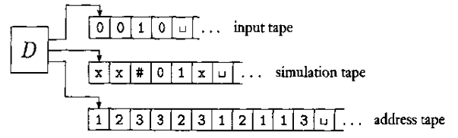
Proof
Simulating deterministic TM D has three tapes
  Tape 1 always contains the input string and is never altered.
  Tape2 maintains a copy of N’s tape on some branch of its nondeterministic computation.
  Tape3 keeps track of D’s location in N’s nondeterministic computation tree.

Slide 27
Tape 3
Every node in the tree have at most b children，where b is the size of the largest set of possible choices given by N’s transition function.
To every children in the tree we assign an address that is a string over the alphabet Σ_{b}={1,2,..,b}
We assign the address 231 to the node we arrive at by starting at the root, going to its 2nd child, …
1
2
3
4
21
22
23
24
231
232
233

Slide 28
Description of TM D
1. Initially tape 1 contains the input w, and tape 2 and 3 are empty
2. Copy tape 1 to tape 2
3. Use tape 2 to simulate N with input w on one branch of its nondeterministic computation. Before N, consult next symbol on tape 3 to determine which choice to make among those N’s transition function.

Slide 29
If no more symbol remain on tape 3 or if this deterministic choice is invalid, go to stage 4. Also go to stage 4 if a rejecting configuration happened. If an accepting configuration is encountered, accept the input
4. Replace the string on tape 3 with the lexicographically next string to simulate the next branch of N’s computation by going to stage 2. (字典序)
2
3
23
231
232

Slide 30
A language is Turing-recognizable if and only if some nondeterministic Turing machine recognizes it.
Proof: Any deterministic Turing machine is automatically a nondeterministic Turing machine, and so one direction of this theorem follows immediately.

Slide 31
A language is Turing-recognizable if and only
if some nondeterministic Turing machine
recognizes it.
Proof.
Any deterministic TM is automatically a
nondeterministic TM, and so one direction
of this theorem follows immediately.The other
direction we have already proved.

Slide 32
Corollary:
A language is decidable if and only if some
nondeterministic Turing machine decides it.

Slide 33
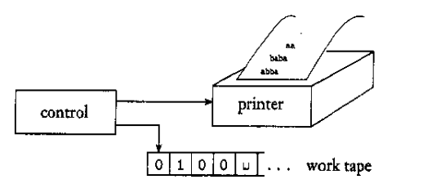
Enumerators
Term Recursively enumerable language for Turing-recognizable language
An enumerator is a Turing machine with an attached printer. Every time Turing machine wants to add a string to the list, it sends the string to the printer.

Slide 34
Enumerator E starts with a blank input tape.
If the enumerator doesn’t halt, it may print an infinite list of strings.
The language enumerated by E is the collection of all the strings that is eventually prints out.

Slide 35
Theorem
A language is Turing-recognizable if and only if some enumerator enumerates it

Slide 36
Prove
If we have an enumerator E that enumerates a language A, A TM M recognizes A.
The TM M works: “ on input w:
  1. Run E. Every time that E outputs a string, compare it with w.
  2. If w ever appears in the output of E, accept.”
Clearly, Accept those strings that appear on E’s list.

Slide 37
If TM M recognizes a language A, we can construct the following enumerator E for A.
Say that s1,s2,s3,… is list of all possible strings in ∑*.
E=“Ignore the input.
  Repeat the following for i=1,2,3…
    Run M for i steps on each input, s1,s2,…,sj.
    If any computations accept, print out the corresponding sj.”
If M accepts a particular string s, eventually it will appear on the list generated by E.

Slide 38
Pascal ⬄ Lisp
Two computational models that satisfy certain reasonable requirements can simulate one another and hence are equivalent power.

Slide 39
Outline
Variations of the Standard Model
Simulation
Turing Machines with Stay-Option
Multitape Turing Machines
Nondeterministic Turing Machines
Enumerators

